Slide 1
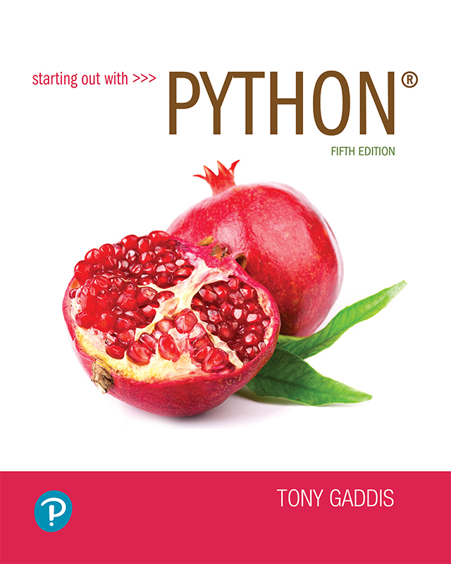
Starting out with Python
Fifth Edition
Chapter 7
Lists and Tuples
Copyright © 2021, 2018, 2015 Pearson Education, Inc. All Rights Reserved

Slide 2
Topics (1 of 2)
Sequences
Introduction to Lists
List Slicing
Finding Items in Lists with the in Operator
List Methods and Useful Built-in Functions

Slide 3
Topics (2 of 2)
Copying Lists
Processing Lists
List Comprehensions
Two-Dimensional Lists
Tuples
Plotting List Data with the matplotlib Package

Slide 4
Sequences
Sequence: an object that contains multiple items of data
  The items are stored in sequence one after another
Python provides different types of sequences, including lists and tuples
  The difference between these is that a list is mutable and a tuple is immutable

Slide 5
Introduction to Lists (1 of 2)
List: an object that contains multiple data items
  Element: An item in a list
  Format: list = [item1, item2, etc.]
  Can hold items of different types
print function can be used to display an entire list
list() function can convert certain types of objects to lists

Slide 6
Introduction to Lists (2 of 2)
Figure 7-1 A list of integers
Figure 7-2 A list of strings
Figure 7-3 A list holding different types

Slide 7
The Repetition Operator and Iterating over a List
Repetition operator: makes multiple copies of a list and joins them together
  The * symbol is a repetition operator when applied to a sequence and an integer
    Sequence is left operand, number is right
  General format: list * n
You can iterate over a list using a for loop
  Format: for x in list:

Slide 8
Indexing
Index: a number specifying the position of an element in a list
  Enables access to individual element in list
  Index of first element in the list is 0, second element is 1, and n’th element is n-1
  Negative indexes identify positions relative to the end of the list
    The index -1 identifies the last element, -2 identifies the next to last element, etc.

Slide 9
The len function
An IndexError exception is raised if an invalid index is used
len function: returns the length of a sequence such as a list
  Example: size = len(my_list)
  Returns the number of elements in the list, so the index of last element is len(list)-1
  Can be used to prevent an IndexError exception when iterating over a list with a loop

Slide 10
Lists Are Mutable
Mutable sequence: the items in the sequence can be changed
  Lists are mutable, and so their elements can be changed
An expression such as
list[1] = new_value can be used to assign a new value to a list element
  Must use a valid index to prevent raising of an IndexError exception

Slide 11
Concatenating Lists
Concatenate: join two things together
The + operator can be used to concatenate two lists
  Cannot concatenate a list with another data type, such as a number
The += augmented assignment operator can also be used to concatenate lists

Slide 12
List Slicing
Slice: a span of items that are taken from a sequence
  List slicing format: list[start : end]
  Span is a list containing copies of elements from start up to, but not including, end
    If start not specified, 0 is used for start index
    If end not specified, len(list) is used for end index
  Slicing expressions can include a step value and negative indexes relative to end of list

Slide 13
Finding Items in Lists with the in Operator
You can use the in operator to determine whether an item is contained in a list
  General format: item in list
  Returns True if the item is in the list, or False if it is not in the list
Similarly you can use the not in operator to determine whether an item is not in a list

Slide 14
List Methods and Useful Built-in Functions (1 of 4)
append(item): used to add items to a list – item is appended to the end of the existing list
index(item): used to determine where an item is located in a list
  Returns the index of the first element in the list containing item
  Raises ValueError exception if item not in the list

Slide 15
List Methods and Useful Built-in Functions (2 of 4)
insert(index, item): used to insert item at position index in the list
sort(): used to sort the elements of the list in ascending order
remove(item): removes the first occurrence of item in the list
reverse(): reverses the order of the elements in the list

Slide 16
List Methods and Useful Built-in Functions (3 of 4)
Table 7-1 A few of the list methods
Method | Description
append(item) | Adds item to the end of the list.
index(item) | Returns the index of the first element whose value is equal to item. A ValueError exception is raised if item is not found in the list.
insert(index, item) | Inserts item into the list at the specified index. When an item is inserted into a list, the list is expanded in size to accommodate the new item. The item that was previously at the specified index, and all the items after it, are shifted by one position toward the end of the list. No exceptions will occur if you specify an invalid index. If you specify an index beyond the end of the list, the item will be added to the end of the list. If you use a negative index that specifies an invalid position, the item will be inserted at the beginning of the list.
sort() | Sorts the items in the list so they appear in ascending order (from the lowest value to the highest value).
remove(item) | Removes the first occurrence of item from the list. A ValueError exception is raised if item is not found in the list.
reverse() | Reverses the order of the items in the list.

Slide 17
List Methods and Useful Built-in Functions (4 of 4)
del statement: removes an element from a specific index in a list
  General format: del list[i]
min and max functions: built-in functions that returns the item that has the lowest or highest value in a sequence
  The sequence is passed as an argument

Slide 18
Copying Lists (1 of 2)
To make a copy of a list you must copy each element of the list
  Two methods to do this:
    Creating a new empty list and using a for loop to add a copy of each element from the original list to the new list
    Creating a new empty list and concatenating the old list to the new empty list

Slide 19

Copying Lists (2 of 2)
Figure 7-5 list1 and list2 reference the same list

Slide 20
Processing Lists (1 of 2)
List elements can be used in calculations
To calculate total of numeric values in a list use loop with accumulator variable
To average numeric values in a list:
  Calculate total of the values
  Divide total of the values by len(list)
List can be passed as an argument to a function

Slide 21
Processing Lists (2 of 2)
A function can return a reference to a list
To save the contents of a list to a file:
  Use the file object’s writelines method
    Does not automatically write \n at then end of each item
  Use a for loop to write each element and \n
To read data from a file use the file object’s readlines method

Slide 22
List Comprehensions (1 of 7)
List comprehension: a concise expression that creates a new list by iterating over the elements of an existing list.

Slide 23
List Comprehensions (2 of 7)
The following code uses a for loop to make a copy of a list:
The following code uses a list comprehension to make a copy of a list:
list1 = [1, 2, 3, 4]
list2 = []
for item in list1:
list2.append(item)
list1 = [1, 2, 3, 4]
list2 = [item for item in list1]

Slide 24
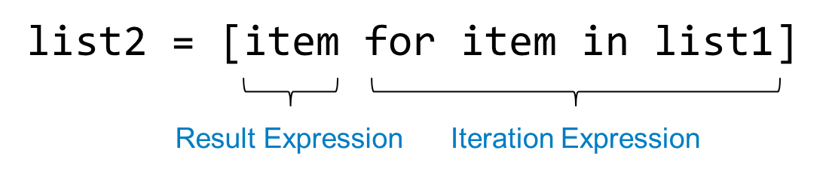
List Comprehensions (3 of 7)
The iteration expression works like a for loop
In this example, it iterates over the elements of list1
Each time it iterates, the target variable item is assigned the value of an element.
At the end of each iteration, the value of the result expression is appended to the new list.

Slide 25
List Comprehensions (4 of 7)
list1 = [1, 2, 3, 4]
list2 = [item**2 for item in list1]
After this code executes, list2 will contain the values [1, 4, 9, 16]

Slide 26
List Comprehensions (5 of 7)
str_list = ['Winken', 'Blinken', 'Nod']
len_list = [len(s) for s in str_list]
After this code executes, len_list will contain the values [6, 7, 3]

Slide 27
List Comprehensions (6 of 7)
You can use an if clause in a list comprehension to select only certain elements when processing a list
list1 = [1, 12, 2, 20, 3, 15, 4]
list2 = []
for n in list1:
if n < 10:
list2.append(n)
Works the same as…
list1 = [1, 12, 2, 20, 3, 15, 4]
list2 = [item for item in list1 if item < 10]

Slide 28
List Comprehensions (7 of 7)
list1 = [1, 12, 2, 20, 3, 15, 4]
list2 = [item for item in list1 if item < 10]
After this code executes, list2 will contain [1, 2, 3, 4]

Slide 29
Two-Dimensional Lists (1 of 3)
Two-dimensional list: a list that contains other lists as its elements
  Also known as nested list
  Common to think of two-dimensional lists as having rows and columns
  Useful for working with multiple sets of data
To process data in a two-dimensional list need to use two indexes
Typically use nested loops to process

Slide 30
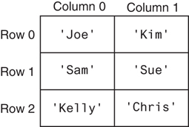
Two-Dimensional Lists (2 of 3)
Figure 7-8 A two-dimensional list

Slide 31
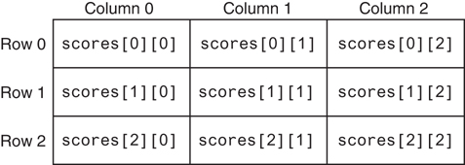
Two-Dimensional Lists (3 of 3)
Figure 7-10 Subscripts for each element of the scores list

Slide 32
Tuples (1 of 3)
Tuple: an immutable sequence
  Very similar to a list
  Once it is created it cannot be changed
  Format: tuple_name = (item1, item2)
  Tuples support operations as lists
    Subscript indexing for retrieving elements
    Methods such as index
    Built in functions such as len, min, max
    Slicing expressions
    The in, +, and * operators

Slide 33
Tuples (2 of 3)
Tuples do not support the methods:
  append
  remove
  insert
  reverse
  sort

Slide 34
Tuples (3 of 3)
Advantages for using tuples over lists:
  Processing tuples is faster than processing lists
  Tuples are safe
  Some operations in Python require use of tuples
list() function: converts tuple to list
tuple() function: converts list to tuple

Slide 35
Plotting Data with matplotlib (1 of 4)
The matplotlib package is a library for creating two-dimensional charts and graphs.
It is not part of the standard Python library, so you will have to install it separately, after you have installed Python on your system.

Slide 36
Plotting Data with matplotlib (2 of 4)
To install matplotlib on a Windows system, open a Command Prompt window and enter this command:
To install matplotlib on a Mac or Linux system, open a Terminal window and enter this command:
See Appendix F in your textbook for more information about packages and the pip utility.
pip install matplotlib
sudo pip3 install matplotlib

Slide 37
Plotting Data with matplotlib (3 of 4)
To verify the package was installed, start IDLE and enter this command:
If you don't see any error messages, you can assume the package was properly installed.
>>> import matplotlib

Slide 38
Plotting Data with matplotlib (4 of 4)
The matplotlib package contains a module named pyplot that you will need to import.
Use the following import statement to import the module and create an alias named plt:
import matplotlib.pyplot as plt
For more information about the import statement, see Appendix E in your textbook.

Slide 39
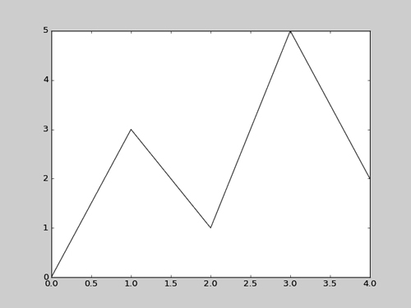
Plotting a Line Graph with the plot Function (1 of 4)
Use the plot function to create a line graph that connects a series of points with straight lines.
The line graph has a horizontal X axis, and a vertical Y axis.
Each point in the graph is located at a (X,Y) coordinate.

Slide 40
Plotting a Line Graph with the plot Function (2 of 4)
Program 7-20 (line_graph1.py)
1 # This program displays a simple line graph.
2 import matplotlib.pyplot as plt
3
4 def main():
5 # Create lists with the X and Y coordinates of each data point.
6 x_coords = [0, 1, 2, 3, 4]
7 y_coords = [0, 3, 1, 5, 2]
8
9 # Build the line graph.
10 plt.plot(x_coords, y_coords)
11
12 # Display the line graph.
13 plt.show()
14
15 # Call the main function.
16 if _ _name_ _ == '_ _main_ _':
17 main()

Slide 41
Plotting a Line Graph with the plot Function (3 of 4)
You can change the lower and upper limits of the X and Y axes by calling the xlim and ylim functions. Example:
This code does the following:
  Causes the X axis to begin at 1 and end at 100
  Causes the Y axis to begin at 10 and end at 50
plt.xlim(xmin=1, xmax=100)
plt.ylim(ymin=10, ymax=50)

Slide 42
Plotting a Line Graph with the plot Function (4 of 4)
You can customize each tick mark’s label with the xticks and yticks functions.
These functions each take two lists as arguments.
  The first argument is a list of tick mark locations
  The second argument is a list of labels to display at the specified locations.
plt.xticks([0, 1, 2, 3, 4],
['2016', '2017', '2018', '2019', '2020'])
plt.yticks([0, 1, 2, 3, 4, 5],
['$0m', '$1m', '$2m', '$3m', '$4m', '$5m'])

Slide 43
Program 7-20
1 # This program displays a simple line graph.
2 import matplotlib.pyplot as plt
3
4 def main():
5 # Create lists with the X,Y coordinates of each data point.
6 x_coords = [0, 1, 2, 3, 4]
7 y_coords = [0, 3, 1, 5, 2]
8
9 # Build the line graph.
10 plt.plot(x_coords, y_coords, marker='o')
11
12 # Add a title.
13 plt.title('Sales by Year')
14
15 # Add labels to the axes.
16 plt.xlabel('Year')
17 plt.ylabel('Sales')
18
Continued. . .

Slide 44
Program 7-24
19 # Customize the tick marks.
20 plt.xticks([0, 1, 2, 3, 4],
21 ['2016', '2017', '2018', '2019', '2020'])
22 plt.yticks([0, 1, 2, 3, 4, 5],
23 ['$0m', '$1m', '$2m', '$3m', '$4m', '$5m'])
24
25 # Add a grid.
26 plt.grid(True)
27
28 # Display the line graph.
29 plt.show()
30
31 # Call the main function.
32 if __name__ == '__main__':
33 main()

Slide 45
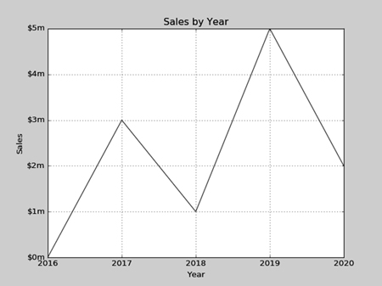
Output of Program 7-24
Displayed by the yticks() function.
Displayed by the title() function.
Displayed by the ylabel() function.
Displayed by the xticks() function.
Displayed by the xlabel() function.

Slide 46
Plotting a Bar Chart (1 of 6)
Use the bar function in the matplotlib.pyplot module to create a bar chart.
The function needs two lists: one with the X coordinates of each bar’s left edge, and another with the heights of each bar, along the Y axis.

Slide 47
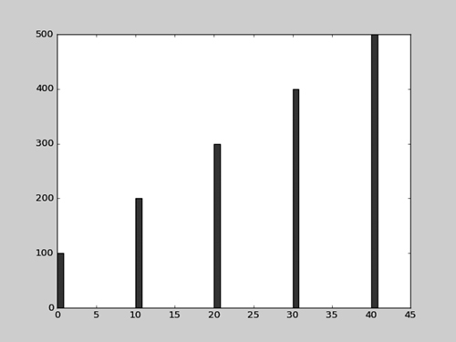
Plotting a Bar Chart (2 of 6)
left_edges = [0, 10, 20, 30, 40]
heights = [100, 200, 300, 400, 500]
plt.bar(left_edges, heights)
plt.show()

Slide 48
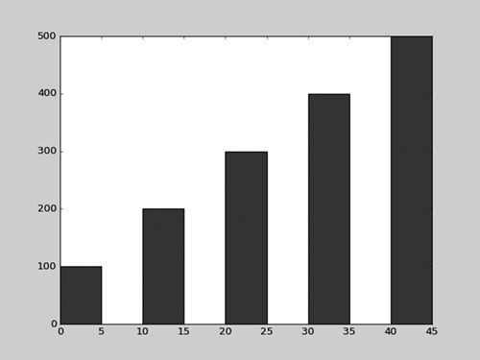
Plotting a Bar Chart (3 of 6)
The default width of each bar in a bar graph is 0.8 along the X axis.
You can change the bar width by passing a third argument to the bar function.
left_edges = [0, 10, 20, 30, 40]
heights = [100, 200, 300, 400, 500]
bar_width = 5
plt.bar(left_edges, heights, bar_width)
plt.show()

Slide 49
Plotting a Bar Chart (4 of 6)
The bar function has a color parameter that you can use to change the colors of the bars.
The argument that you pass into this parameter is a tuple containing a series of color codes.
Color Code | Corresponding Color
'b' | Blue
'g' | Green
'r' | Red
'c' | Cyan
'm' | Magenta
'y' | Yellow
'k' | Black
'w' | White

Slide 50
Plotting a Bar Chart (5 of 6)
Example of how to pass a tuple of color codes as a keyword argument:
The colors of the bars in the resulting bar chart will be as follows:
  The first bar will be red.
  The second bar will be green.
  The third bar will be blue.
  The fourth bar will be white.
  The fifth bar will be black.
plt.bar(left_edges, heights, color=('r', 'g', 'b', 'w', 'k'))

Slide 51
Plotting a Bar Chart (6 of 6)
Use the xlabel and ylabel functions to add labels to the X and Y axes.
Use the xticks function to display custom tick mark labels along the X axis
Use the yticks function to display custom tick mark labels along the Y axis.

Slide 52
Plotting a Pie Chart (1 of 4)
You use the pie function in the matplotlib.pyplot module to create a pie chart.
When you call the pie function, you pass a list of values as an argument.
  The sum of the values will be used as the value of the whole.
  Each element in the list will become a slice in the pie chart.
  The size of a slice represents that element's value as a percentage of the whole.

Slide 53
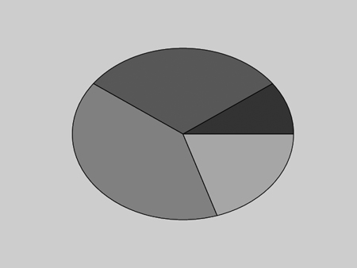
Plotting a Pie Chart (2 of 4)
Example
values = [20, 60, 80, 40]
plt.pie(values)
plt.show()

Slide 54
Plotting a Pie Chart (3 of 4)
The pie function has a labels parameter that you can use to display labels for the slices in the pie chart.
The argument that you pass into this parameter is a list containing the desired labels, as strings.

Slide 55
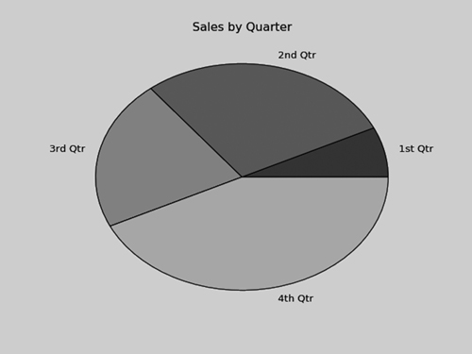
Plotting a Pie Chart (4 of 4)
Example
sales = [100, 400, 300, 600]
slice_labels = ['1st Qtr', '2nd Qtr', '3rd Qtr', '4th Qtr']
plt.pie(sales, labels=slice_labels)
plt.title('Sales by Quarter')
plt.show()

Slide 56
Plotting a Pie Chart
The pie function automatically changes the color of the slices, in the following order:
  blue, green, red, cyan, magenta, yellow, black, and white.
You can specify a different set of colors, however, by passing a tuple of color codes as an argument to the pie function’s colors parameter:
When this statement executes, the colors of the slices in the resulting pie chart will be red, green, blue, white, and black.
plt.pie(values, colors=('r', 'g', 'b', 'w', 'k'))

Slide 57
Summary
This chapter covered:
  Lists, including:
    Repetition and concatenation operators
    Indexing
    Techniques for processing lists
    Slicing and copying lists
    List methods and built-in functions for lists
    Two-dimensional lists
  Tuples, including:
    Immutability
    Difference from and advantages over lists
  Plotting charts and graphs with the matplotlib Package

